Slide 1
Signal Degradation in the Optical Fiber
Signal Attenuation
It determines the maximum unamplified or repeaterless distance between transmitter and receiver.
Signal Distortion
Causes optical pulses broaden.
Overlapping with neighboring pulses, creating errors in the receiver output.
It limits the information carrying capacity of a fiber.

Slide 2

Signal attenuation- Known as signal loss
Level of attenuation has the ability to determine cost of system
In optical fiber communications the attenuation is usually expressed in decibels per unit length (i.e. dB km−1) following:
where αdB is the signal attenuation per unit length in decibels which is also referred to as the fiber loss parameter and L is the fiber length.

Slide 3
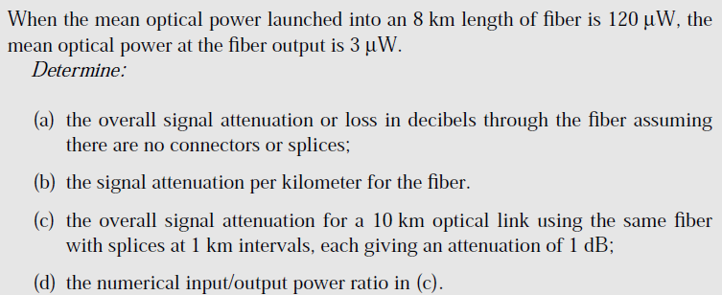

Slide 4
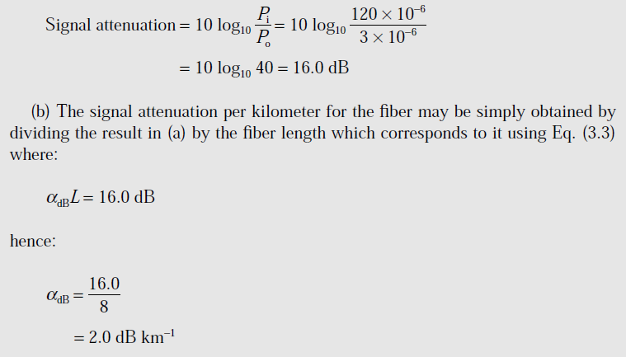

Slide 5
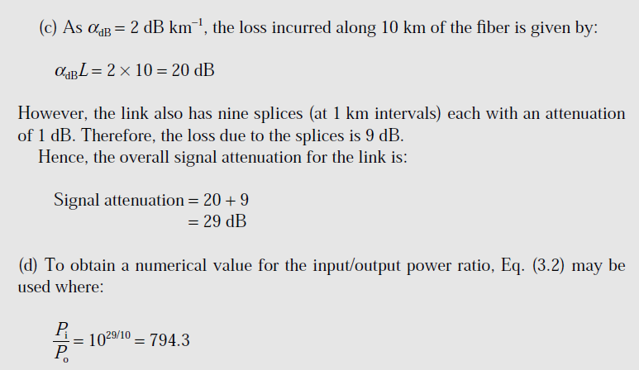

Slide 6
Attenuation
The Basic attenuation mechanisms in a fiber:
Absorption:
It is related to the fiber material.
2. Scattering:
It is associated both with the fiber material and with the structural imperfections in the optical waveguide.
3. Radiative losses/ Bending losses:
It originates from perturbation (both microscopic and macroscopic) of the fiber geometry.

Slide 7
Material Absorption
Material absorption is a loss mechanism related to the material composition and the fabrication process for the fiber, which results in the dissipation of some of the transmitted optical power as heat in the waveguide.
Absorption is caused by
Absorption by atomic defects in glass composition
Extrinsic absorption by impurity atoms in glass material
Intrinsic absorption by basic constituent atoms of fiber materials

Slide 8
Absorption by atomic defects
Atomic defects are imperfections in atomic structure of fiber material.
Examples
Missing molecules
High density clusters of atom groups
Oxygen defects in the glass structure
Atomic defects are small compared to intrinsic and extrinsic absorption unless fiber is exposed to ionizing radiation as nuclear reactor environment, in medical radiation therapies and in accelerator instrumentation.

Slide 9
Intrinsic absorption
Intrinsic absorption is associated with basic fiber material (e.g. pure SiO2)
Caused by interaction with one or more of the major components of the glass.
It occurs when material is in a perfect state with no density variations, impurities and material inhomogenities.
Results from
Electronic absorption band in UV region
Atomic vibration bands in near IR region

Slide 10
UV absorption
Electronic absorption bands are associated with band gaps of glass materials.
Absorption occurs when a light particle (photon) interacts with an electron in valence band and excites it to a higher energy level. The tail of the ultraviolet absorption band is shown in figure.
UV loss (dB/km) at any wavelength can be expressed empirically as mole fraction x as
UV absorption is stronger for shorter wavelength .
That is UV absorption decays exponentially with increasing wavelength.
UV loss is small compare to IR loss

Slide 11
Infrared absorption
In near IR above 1.2μm, the optical waveguide loss is predominantly determined by presence of OH ions and inherent infrared absorption.
The inherent IR absorption is associated with characteristic vibration frequency of particular chemical bond between the atoms of which the fiber is composed.
Interaction between the vibrating bond and electromagnetic field of optical signal results in a transfer of energy from field to bond thereby giving rise to absorption.
This is very strong because many bonds present in fiber.
An empirical formula (dB/km) for GeO2-SiO2 is

Slide 12
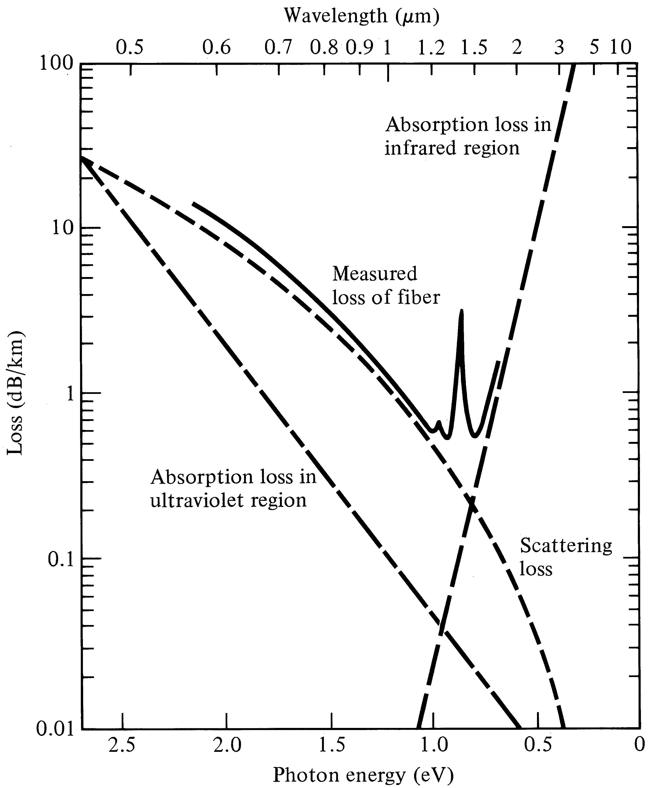
Fig: Attenuation spectra for intrinsic loss mechanism in pure GeO2- SiO2 glass

Slide 13
However, the effects of both these processes may be minimized by suitable choice of both core and cladding compositions.
In some nonoxide glasses such as fluorides and chlorides , the infrared absorption peaks occur at much longer wave lengths.
They do not effect optical communications much.

Slide 14
Extrinsic absorption
The dominant absorption factor in silica fibers is the presence of minute quantities of impurities in the material.(mainly due to melting method)
These include OH (water) ions that are dissolved in the glass and transition metal ions such as iron, copper, chromium and vanadium.
In 1970s these impurities levels were found 1 part per million(ppm) in fibers and causes the attenuation around 1 to 4dB/Km

Slide 15
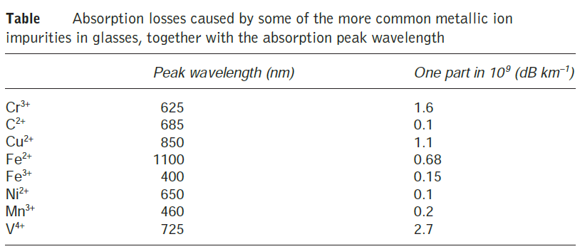

Slide 16
Cont….
Impurity absorption occurs either because of electron transitions between the energy levels within these ions or because of charge transitions between these ions.
Modern vapor phase fiber techniques for producing fibers reduced the amount of such impurities.
The high levels of OH ions in early fibers results in large absorption peaks at 725,950 ,1240 and 1380 nm.
Region of low attenuation lie between these peaks.

Slide 17
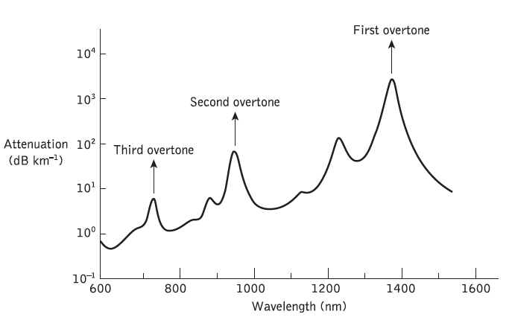
The peaks and valleys in attenuation curves resulted in designation of various transmission windows and bands like window 1,2 and 3 and S, O and C bands.

Slide 18
By reducing the residual OH contents of fibers below 1 ppb, (parts per billion) standard single mode fibers have nominal attenuation of 0.4 dB/Km (O band) at 1310 nm and 0.2 dB/Km at 1550 nm (C band)
Further reduction of OH ions results in elimination of absorption peak around 1440nm and thus opens for E band for data transmission

Slide 19
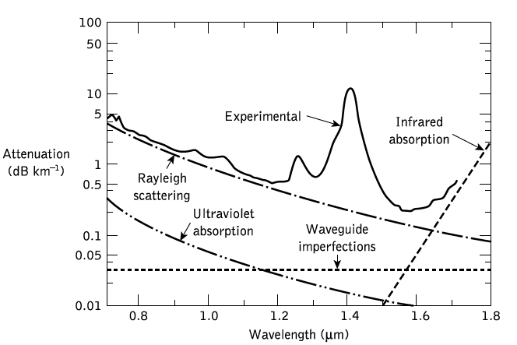


Slide 20
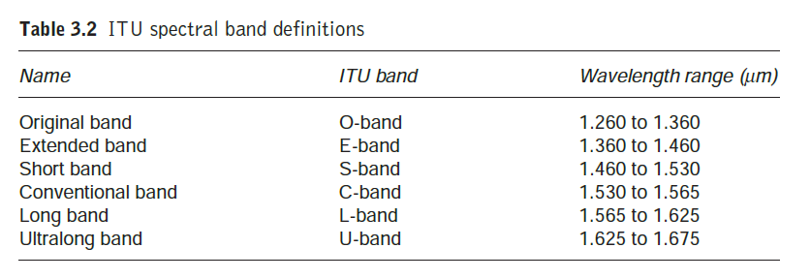

Slide 21
Scattering Losses
Scattering losses are caused by the interaction of light with density fluctuations within a fiber.
During manufacturing, regions of higher and lower molecular density areas, relative to the average density of the fiber, are created.
Scattering loss in glass arise from microscopic variations in material density, compositional fluctuations, and from structural
inhomogeneities or defect occurring during fiber manufacture.
2 types are there 1) Linear scattering
2) Non linear scattering

Slide 22
Linear scattering
Scattering is a process whereby all or some of the optical power within one propagating mode to be transferred into another mode.
Frequently causes attenuation, since the transfer is often to a mode that does not propagate well within the fiber core but is radiated from the fiber. (also called a leaky or radiation mode).
Classified into two.
Rayleigh scattering
Mie scattering

Slide 23
Rayleigh scattering
Rayleigh scattering is the dominant intrinsic loss mechanism in the low-absorption window between the ultraviolet and infrared absorption tails.
This density fluctuations in the glass rise to refractive index variations which occur within the glass over distances that are small compared with wavelength.
This arises from density and compositional variations which are frozen into the glass lattice on cooling.
The compositional variations may be reduced by improved fabrication.
The index fluctuations caused by the freezing-in of density inhomogeneities are fundamental and cannot be avoided.

Slide 24

The subsequent scattering due to the density fluctuations, which is in almost all directions, produces an attenuation proportional to 1/λ4
Rayleigh scattering coefficient is given by
λ is the optical wavelength, n is the refractive
index of the medium, p is the average photoelastic coefficient, βc is the isothermal compressibility at a fictive temperature TF, and K is Boltzmann’s constant.
The fictive temperature is defined as the temperature at which the glass can reach a state of thermal equilibrium and is closely related to the anneal temperature.

Slide 25

The Rayleigh scattering coefficient is related to the transmission loss factor (transmissivity) of the fiber following the relation
L- length of the fiber
Rayleigh scattering loss decreases dramatically with increasing wavelength
Raleigh scattering causes the sky to be blue, since only the short (blue) wavelengths are significantly scattered by the air molecules.)

Slide 26
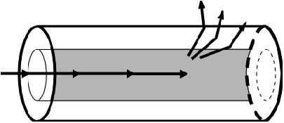
Schematic of Rayleigh scattering
Mie Scattering
caused in inhomogeneities which are comparable in size to the guided wavelength.
These result from the non-perfect cylindrical structure of the waveguide and may be caused by fiber imperfections such as irregularities in the core-cladding interface, core-cladding refractive index differences along the fiber length, diameter fluctuations, strains and bubbles.

Slide 27
The scattering created by such inhomogeneities is mainly in the forward direction and is called Mie scattering.
The inhomogeneities may be reduced by:
removing imperfections due to the glass manufacturing process
increasing the fiber guidance by increasing the relative refractive index difference
carefully controlled coating of the fiber.

Slide 28
Nonlinear scattering losses
Non linear scattering causes the power from one mode to be transferred in either the forward or backward direction to the same or other modes, at the different frequency.
The most important types are;
1. Stimulated Brillouin
2. Raman scattering
Both are usually only observed at high optical power density in long single mode fibers

Slide 29
Stimulated Brillouin Scattering
Stimulated Brillouin scattering (SBS) may be regarded as the modulation of light through thermal molecular vibrations within the fiber.
The scattered light appears as upper and lower sidebands which are separated from the incident light by the modulation frequency.
The incident photon produces a phonon* of acoustic frequency as well as a scattered photon.

Slide 30
phonon is a mode of oscillation that occurs in lattice structures.
A phonon is a mode of vibration, which is neither a wave nor a particle.
This produces an optical frequency shift which varies with the scattering angle because the frequency of the sound wave varies with acoustic wavelength.
The photon can loose or gain energy and hence change its frequency.
If the photons lose energy, the scattered wave has a longer wavelength and is called the Stokes wave.
If the photons gain energy, the scattered wave has a shorter wavelength and is called the anti-Stokes wave.

Slide 31

The frequency shift is a maximum in the backward direction and ZERO in forward direction . Thus SBS is a backward process.
Brillouin scattering is only significant above a threshold power density.
The threshold power PB is given by:
d and λ are the fiber core diameter and the operating wavelength, both measured in micrometers.
αdB is the fiber attenuation in decibels per kilometer
ν is the source bandwidth (i.e. injection laser) in gigahertz.

Slide 32
Stimulated Raman Scattering
Stimulated Raman scattering (SRS) is similar to SBS except that a high-frequency optical phonon rather than an acoustic phonon is generated in the scattering process.
SRS can occur in both the forward and backward directions in an optical fiber.
It may have an optical power threshold of up to three orders of magnitude higher than the Brillouin threshold in a particular fiber.

Slide 33


The threshold optical power for SRS PR in a long
single-mode fiber is given by:
Numerical

Slide 34
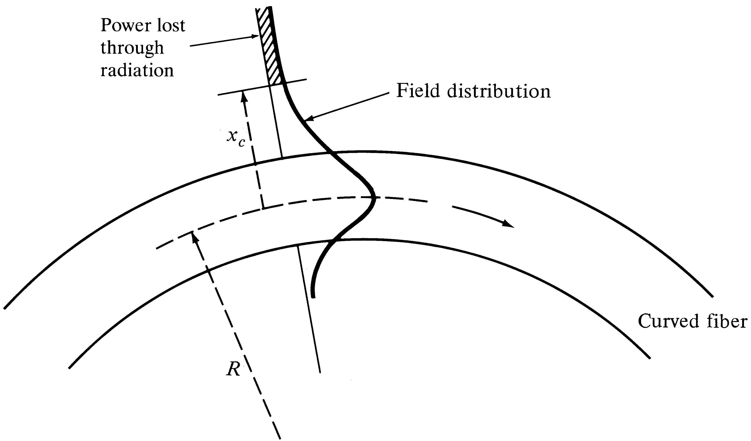
Fiber bend loss
Optical fibers suffer radiation losses at bends or curves on their paths

Slide 35
For the slight bends .losses are unobservable
By decreasing radius of curvature we will come to the critical value after which these losses increase drastically, shown as xc in the fig.
As we know that the electric/magnetic field have a tail in the cladding region so by bending the cable we come to the extent where cladding field should move faster to keep up with the core field.
As this is not possible so the energy in that region radiates away

Slide 36

Radiation losses depend on the value of xc and radius of curvature R
As the lower order modes remain close to the core axis and the higher modes are closer to the cladding so the higher modes will radiate out of the fiber first.
Radius of curvature for multimode fibers is given by the equation

Slide 37


Radius of curvature for single mode fiber is given by
The cutoff wavelength for the single-mode fiber is given by

Slide 38
Microbending losses
Result of microscopic imperfections in the geometry of the fiber.
microscopic bends of the fiber axis that can arise when the fibers are incorporated into cables.
The power is dissipated through the microbended fiber, because of the repetitive coupling of energy between guided modes & the leaky or radiation modes in the fiber.

Slide 39
Macrobending losses
fiber bending with diameters on the order of centimeters.
The curvature of the bend is much larger than fiber diameter.
Lightwave suffers sever loss due to radiation of the evanescent field in the cladding region.
As the radius of the curvature decreases, the loss increases exponentially until it reaches at a certain critical radius.
For any radius a bit smaller than this point, the losses suddenly becomes extremely large.
Higher order modes radiate away faster than lower order modes.

Slide 40
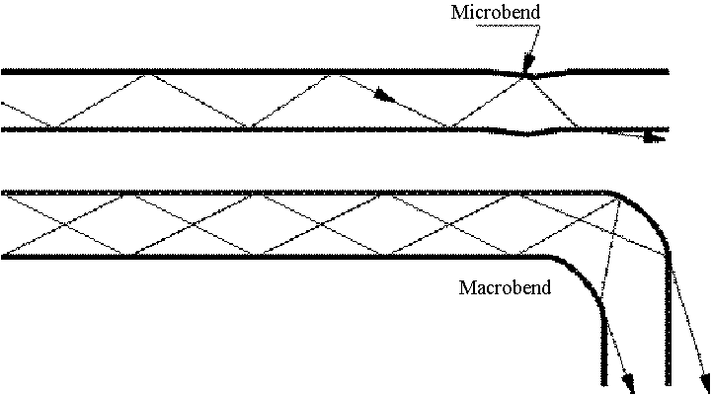
.

Slide 41
DISPERSION
Dispersion of the transmitted optical signal causes distortion for both digital and analog transmission along optical fibers.
The dispersion mechanisms within the fiber cause broadening of the transmitted light pulses as they travel
along the channel.
In following figure, it can be observed that each pulse broadens and overlaps with its neighbors, eventually becoming indistinguishable at the receiver input. This effect is known as Intersymbol interference (ISI).

Slide 42
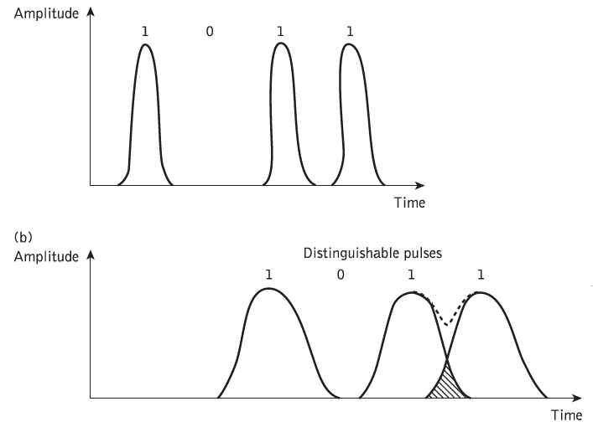
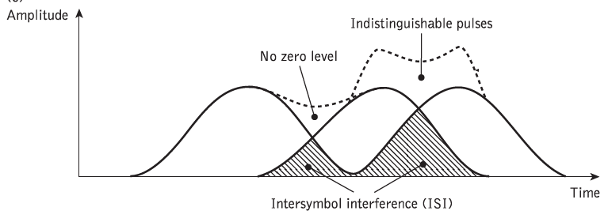

Slide 43

For no overlapping of light pulses down on an optical fiber link the digital bit rate BT must be less than the reciprocal of the broadened (through dispersion) pulse duration (2τ).
This assumes that the pulse broadening due to dispersion on the channel is τ which dictates the input pulse duration which is also τ.
second assumption is that input pulses take the shape of impulse.

Slide 44

More accurate estimate of the maximum bit rate is obtained by considering the light pulses at the output to have a Gaussian shape with an rms width of σ.
For non return to zero code , maximum bandwidth B is
BT = 2B
for return to zero
Here this data rate is equal to bandwidth in hertz.
BT = B

Slide 45
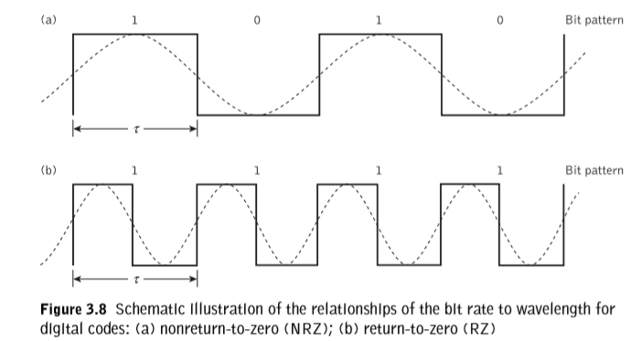

Slide 46
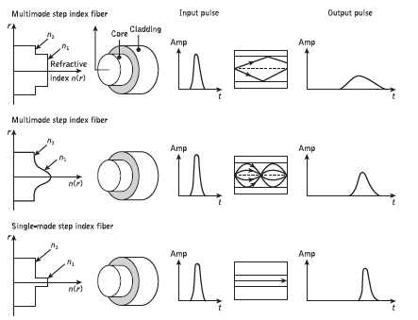
However, signal dispersion alone limits the maximum possible bandwidth attainable with a particular optical fiber
GRADED INDEX

Slide 47
It may be observed that the multimode step index fiber exhibits the greatest dispersion of a transmitted light pulse and the multimode graded index fiber gives a considerably improved performance.
The single-mode fiber gives the minimum pulse broadening and thus is capable of the greatest transmission bandwidths which are currently in the gigahertz range.
Transmission via multimode step index fiber is usually limited to bandwidths of a few tens of megahertz.
The amount of pulse broadening is dependent up on the distance the pulse travels within the fiber.

Slide 48
Thus the measurement of the dispersive properties of a particular fiber is usually stated as the pulse broadening in time over a unit length of the fiber (i.e. ns /km).
Hence, the number of optical signal pulses which may be transmitted in a given period, and therefore the information-carrying capacity of the fiber, is restricted by the amount of pulse dispersion per unit length.
The pulse broadening increases linearly with fiber length and thus the bandwidth is inversely proportional
to distance.

Slide 49
Hence, information-carrying capacity of an optical fiber is defined by using a parameter known as bandwidth length product, Bopt × L.
The typical best bandwidth–length products for the three fibers are 20 MHz km, 1 GHz km and 100 GHz km for multimode step index, multimode graded index and single-mode step index fibers respectively.

Slide 50
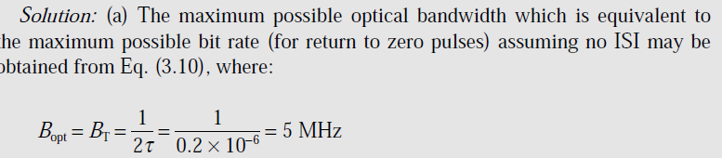
A multimode graded index fiber exhibits total pulse broadening of 0.1 μs over a distance of 15 km. Estimate:
(a) the maximum possible bandwidth on the link assuming no intersymbol interference;
(b) the pulse dispersion per unit length;
(c) the bandwidth–length product for the fiber.
Solution:

Slide 51
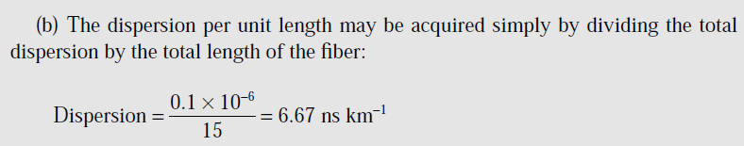

(C)

Slide 52
Most important types
Intramodal or chromatic dispersion
material dispersion
waveguide dispersion
Intermodal/multimode dispersion
polarization mode dispersion (PMD)

Slide 53
Intramodal/chromatic dispersion
It is pulse spreading that takes place within a single mode.
Spreading arises from finite spectral emission width of an optical source.
Spectral width is band of wavelengths over which the source emits light.
Phenomenon is also known as group velocity dispersion, since the dispersion is a result of group velocity being a function of wavelength.
Since this dispersion depends on wavelength, its effect on signal distortion increases with the spectral width of light source.

Slide 54
The wavelength band is normally characterized by RMS spectral bandwidth
Depending on the device structure of LED , the spectral width is approximately 4 to 9% of central wavelength.
If peak wavelength of a LED is 850 nm , spectral width would be 36 nm. So most of the light will be in 832-868 nm wavelength band.
Laser diode optical sources exhibit much narrower optical bandwidth, with typical values being 1-2 nm for multimode lasers and 10^-4 nm for single mode laser.

Slide 55
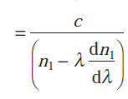
There are 2 main causes for intramodal dispersion.
1) Material dispersion
Arises due to the variation of refractive index of core material as a function of wavelength.
due to different group velocities of various spectral components launched to fiber from the source
Vg
This refractive index property causes a wavelength dependence of the group velocity of a given mode.
So pulse spreading occurs even when different wavelengths follow the same path.

Slide 56

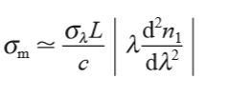

Material dispersion parameter is given by
expressed in units of ps nm−1 km−1.
is the pulse delay due to dispersion
Rms Pulse broadening due to material dispersion
The material dispersion for optical ﬁbers is sometimes quoted as a value for

Slide 57
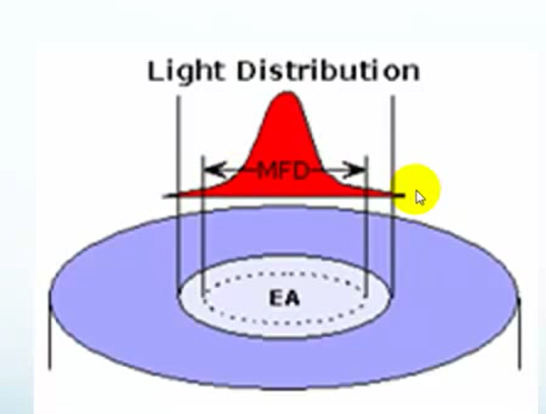
Waveguide dispersion
This causes pulse spreading because only part of the optical power propagation along a fiber is confined to the core.
Dispersion arises because the fraction of light power propagating in the cladding travels faster than the light confined to the core, since high RI is for core, so less velocity.
waveguide dispersion depends on the fiber design.

Slide 58
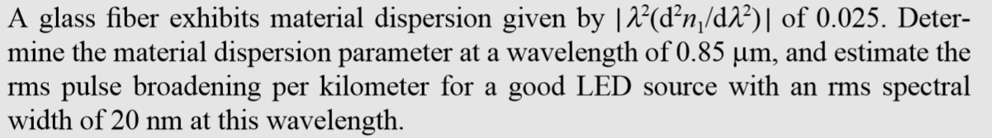

Slide 59
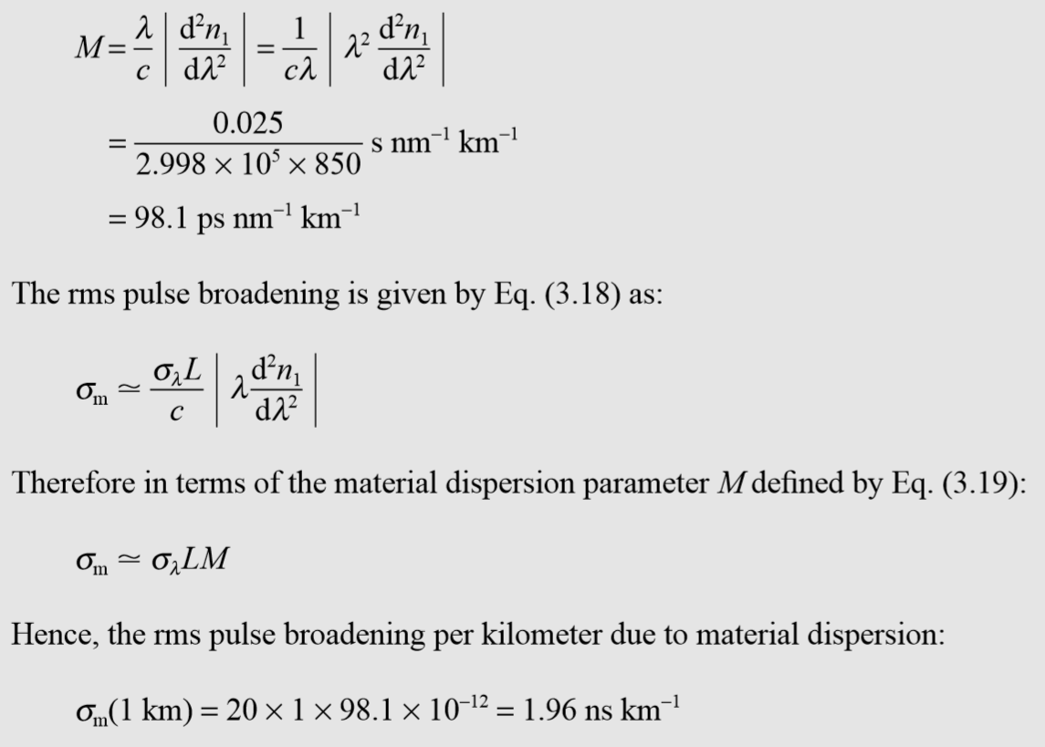

Slide 60
Intermodal Dispersion/ Modal delay
This mechanism is a result of each mode having a different value of group velocity at a single frequency.
The variation in the group velocities of different modes results in a group delay spread, which is intermodal dispersion.
This will be eliminated in single mode of operation and is the most pronounced one in multimode fibers.

Slide 61
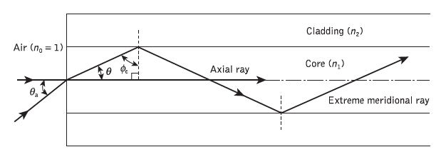
Intermodal dispersion in Multimode step index fibers
Both rays are traveling at the same velocity within the constant refractive index fiber core.
One follows (axial ray) shortest path. It takes less time to reach at destination.
Extreme meridional ray which follows longer path needs more time to reach destination.
This time difference (delay) makes dispersion

Slide 62



Calculation of delay difference
The time taken for the axial ray to travel along a fiber of length L gives the minimum delay time TMin and:
The extreme meridional ray exhibits the maximum delay time TMax where:
Using Snell’s law of refraction at the core–cladding interface

Slide 63

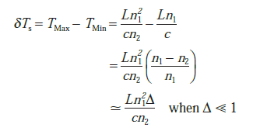

Substituting this to Tmax, gives
Now, Time delay can be obtained by,
where Δ is the relative refractive index difference. However, when Δ <<1,

Slide 64


Rearrange the time delay equation
Also substituting for Δ
It must be noted that this simple analysis only considers pulse broadening due to meridional rays and totally ignores skew rays with acceptance angles θas > θa

Slide 65

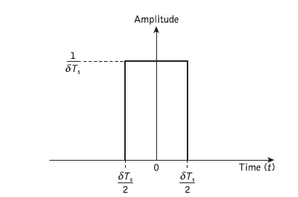
Calculation of RMS pulse broadening
When the optical input to the fiber is a pulse pi(t) of unit area, as illustrated in Figure,

Slide 66


It may be noted that pi(t) has a constant amplitude of 1/δTs over the range
The rms pulse broadening at the fiber output due to intermodal dispersion for the multimode step index fiber σs (i.e. the standard deviation) may be given in terms of the variance ,
Where M1 is equivalent to the mean value of the pulse and M2, is equivalent to the mean square value of the pulse.

Slide 67



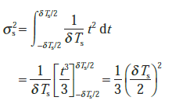
Mean value is zero. So variance,

Slide 68

Hence substituting for δTs gives
The pulse broadening is directly proportional to the relative refractive index difference Δ and the length of the fiber L.
The pulse broadening is reduced by reduction of the relative refractive index difference Δ for the fiber.
But reduction in Δ reduces the acceptance angle θa and the NA, thus worsening the launch conditions

Slide 69
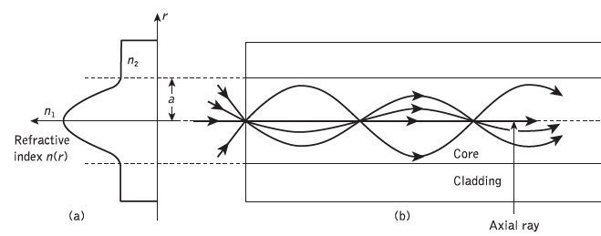
Intermodal dispersion in multimode graded index fiber
Here the velocity difference compensates the different length of different paths.

Slide 70


By considering electromagnetic mode theory, time delay difference for graded index fiber will be given by
rms pulse broadening of a near-parabolic index profile graded index fiber σg is reduced compared with similar broadening for the corresponding step index fiber σ,
where D is a constant between 4 and 10 depending on the precise evaluation and the exact optimum profile chosen.

Slide 71

The best minimum theoretical intermodal rms pulse broadening for a graded index fiber is given by

Slide 72
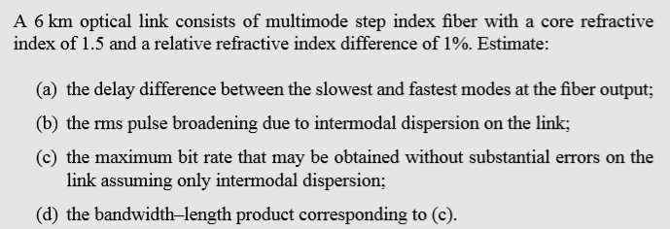

Slide 73
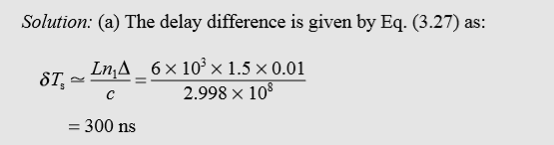
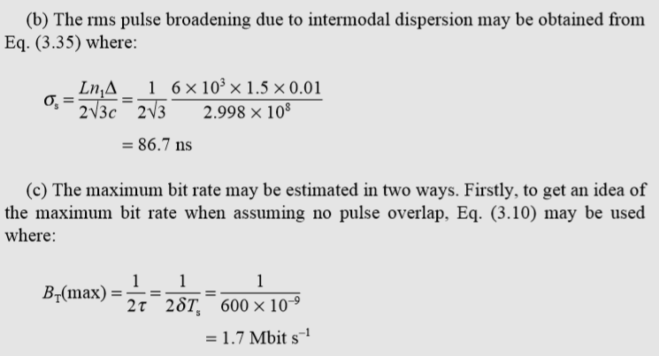

Slide 74
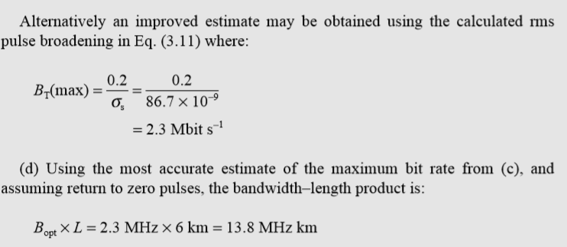

Slide 75
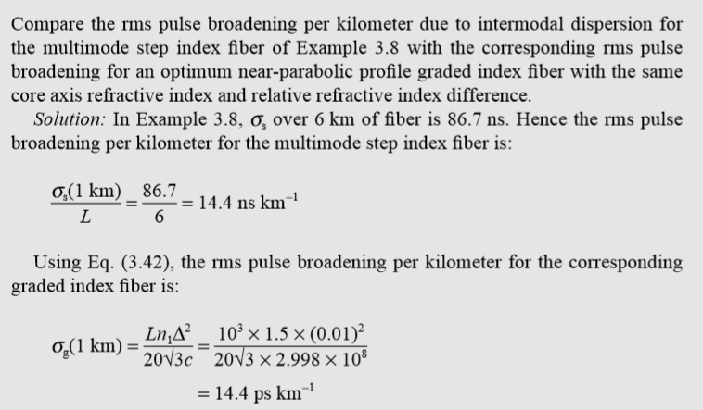

Slide 76
Optical time domain reflectometry (OTDR)
A measurement technique which is far more sophisticated and which finds wide application in both the laboratory and the field is the use of optical time domain reflectometry (OTDR).
This technique is often called the backscatter measurement method.
The other optical attenaution measurement methods provide averaged loss over the whole length measured in dB/Km
When the attenuation on the link varies with length, the averaged loss information is inadequate
OTDR provides measurement of the attenuation on an optical link down its entire length giving information on the length dependence of the link loss.

Slide 77

OTDR also allows splice and connector losses to be evaluated as well as the rotation of any faults on the link.
OTDR relies upon the measurement and analysis of the fraction of light which is reflected back within the fiber’s numerical aperture due to Rayleigh scattering.
The backscattered optical power as a function of time PRa(t) may be obtained from the following relationship
where
Pi is the optical power launched into the fiber
S is the fraction of captured optical power
γR is the Rayleigh scattering coefficient (backscatter loss per unit length),

Slide 78

Wo is the input optical pulse width
vg is the group velocity in the fiber
γ is the attenuation coefficient per unit length for the fiber
The fraction of captured optical power S is given by the ratio of the solid acceptance angle for the fiber to the total solid angle as:
This equation for S applies to step index fibers and the parameter S for a graded index fiber is generally a factor of 2/3 lower than for a step index fiber with the same numerical aperture.
By using these two equations ,It is possible to determine the backscattered optical power from a point along the link length in relation to the forward optical power at that point.

Slide 79
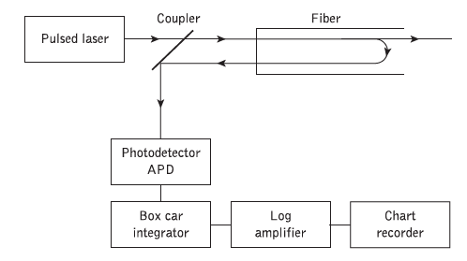
OTDR METHOD
Schematic diagram is shown above.

Slide 80
Working
A light pulse is launched into the fiber in the forward direction from an injection laser using either a directional coupler or a system of external lenses with a beam splitter (usually only in the laboratory).
The backscattered light is detected using an avalanche
photodiode receiver which drives an integrator.
This is in order to improve the received signal-to-noise ratio by giving an arithmetic average over a number of measurements taken at one point within the fiber.
The signal from the integrator is fed through a logarithmic amplifier.
averaged measurements for successive points within the fiber are plotted on a chart recorder.

Slide 81
This provides location-dependent attenuation values which give an overall picture of the optical loss down the link.
Example of possible back scatter plot from a fiber is given in next slide.
It shows the initial pulse caused by reflection and backscatter from the input coupler followed by a long tail caused by the distributed Rayleigh scattering from the input pulse as it travels down the link.
Also shown in the plot is a pulse corresponding to the discrete reflection from a fiber joint, as well as a discontinuity due to excessive loss at a fiber imperfection or fault.
The end of the fiber link is indicated by a pulse corresponding to the Fresnel reflection incurred at the output end face of the fiber.

Slide 82
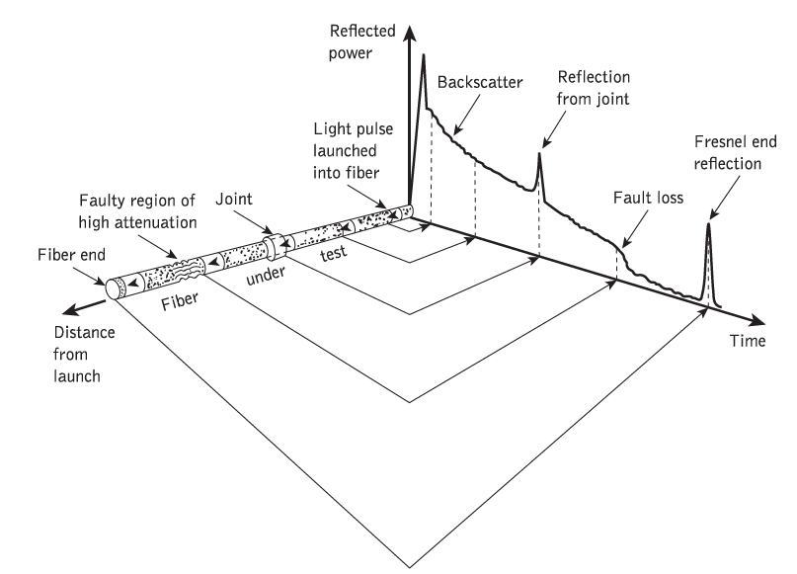

Slide 83
Such a plot yields the attenuation per unit length for the fiber by simply computing the slope of the curve over the length required.
Finally the overall link length can be determined from the time difference between reflections from the fiber input and output end faces.
Commercial availability
OTDR is available for operation in both shorter (0.85 um ) and longer wavelength regions (1.31 and 1.55 um).
The accuracy of distannce measurement is around _{+ or} - _{1 m}

Slide 84
Single-mode fiber optical time domain reflectometers exhibit an additional problem over multimode devices, namely polarization noise.
In general, the state of polarization of the backscattered light differs from that of the laser pulse coupled into the fiber at the input end and is dependent on the distance of the backscattering fiber element from the input fiber end.
This results in an amplitude fluctuation in the backscattered light known as polarization noise.
Interestingly, this same phenomenon can be employed to measure the evolution of the polarization in the fiber with the so-called polarization optical time domain reflectometer
(POTDR)

Slide 85
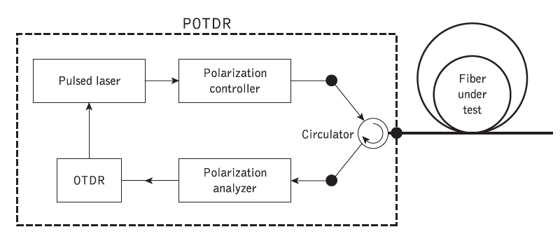
In addition, a major limitation which is encountered with conventional OTDR during the test and measurement process is the presence of polarization mode dispersion (PMD).
The POTDR, however, provides for the measurement of PMD on a fiber link

Slide 86
Figure depicts a block schematic of a POTDR which comprises a conventional OTDR instrument, polarization controller, polarization analyzer and pulsed laser.
The POTDR employs a narrow band external cavity laser or (i.e. with pulse width of 10 ns or less) to give high spatial resolution with respect to the frequency-dependent distortions due to PMD.
The fiber under test is connected to the POTDR using an optical circulator.
Alternatively, an optical fiber coupler can also be used to interface with the POTDR.
The pulses are then sent through the optical circulator towards the fiber under test following which the instrument performs the measurements from the state of polarization (SOP) of the backscattered field.

Slide 87
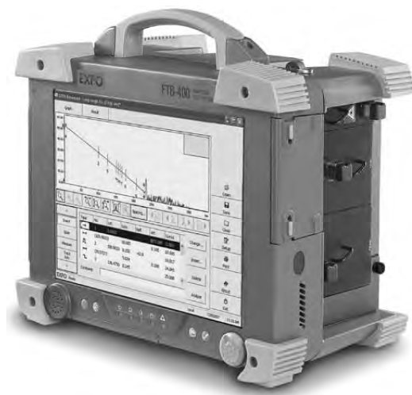
while the polarization controller and polarization analyzer are used to determine both the SOP and degree of polarization (DOP) for the optical signals.
The polarization analyzer then provides the data necessary to construct the OTDR traces.
Optical time domain reflectometer, Model No. EXFO FTB-400

Slide 88
Non linear effects
Non-linearities arise when several high strength optical field from different signal wavelengths are present in the fiber at the same time and when these field interact with acoustic waves and molecular vibrations.
These non-linearities arise above a particular optical power threshold.
So the effect becomes negligible once the signal has become sufficiently attenuated after travelling a certain distance along the fiber.
Non linearities can be classified into 2 categories.
Non linear inelastic scattering process- SBS and SRS
Effects arises from intensity dependent variation in Refractive index– KERR EFFECT

Slide 89
KERR EFFECTS include
(a) Self phase modulation (SPM)
(b) Cross phase modulation (XPM or CPM)
(c) Four wave mixing (FWM)
SBS,SRS and FWM result in gains or losses the power in a wavelength channel.
The power variations depend on the optical signal intensity
SPM and XPM affect only phase of the signal causes chirping in digital pulses . This can worsen pulse broadening due to dispersion.

Slide 90
Self Phase Modulation (SPM) : If an intensity modulated signal propagates in the fibre, the intensity modulation induces an index modulation of the fibre and in return a phase modulation to the signal.
☞ The signal modulates itself
☞ The SPM induced phase modulation broadens the signal
spectrum.
Cross Phase Modulation (XPM) : In the case of a multi–channel propagation, the index modulation induced by the Kerr–effect modulates the other channels and vice-versa.
Four Wave Mixing (FWM) : In the case of a multi–channel propagation and under phase matching conditions, new frequencies are generated in the fibre causing crosstalk and power depletion.

Slide 91


OVERALL FIBER DISPERSION
The overall dispersion in multimode fibers comprises both chromatic and intermodal terms.
The total rms pulse broadening σT is given by
where σc is the intramodal or chromatic broadening and σn is the intermodal broadening caused by delay differences between the modes
Here, for multimode fibers following assumption can be
taken

Slide 92

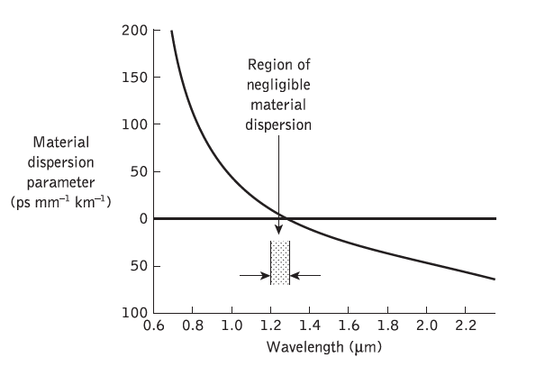
For single mode fibers, total dispersion is given by
However, in standard single-mode fibers the total dispersion tends to be dominated by the material dispersion of fused silica
It is given by the following characteristics

Slide 93
It may be observed that the characteristic goes through zero at a wavelength of 1.27 μm.
This zero material dispersion (ZMD) point can be shifted anywhere in the wavelength range 1.2 to 1.4 μm by the addition of suitable dopants.
However, the ZMD point alone does not represent a point of zero pulse broadening since the pulse
dispersion is influenced by both waveguide and profile dispersion.

Slide 94
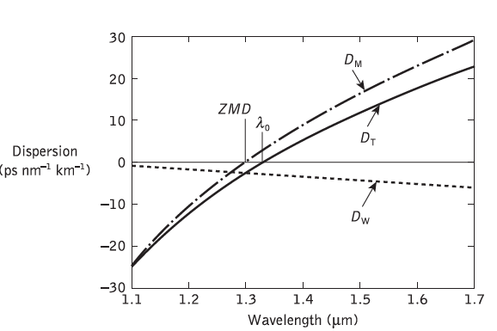
The total fiber dispersion, which depends on both the fiber material composition and dimensions, may be minimized by trading off material and waveguide dispersion while limiting the profile dispersion .
For wavelengths longer than the ZMD point, the material dispersion parameter is positive whereas the waveguide dispersion parameter is negative, as shown in Figure

Slide 95
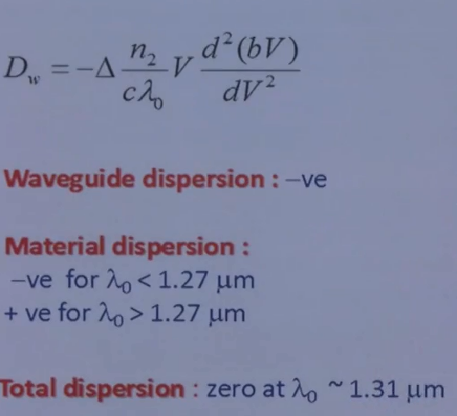

Slide 96
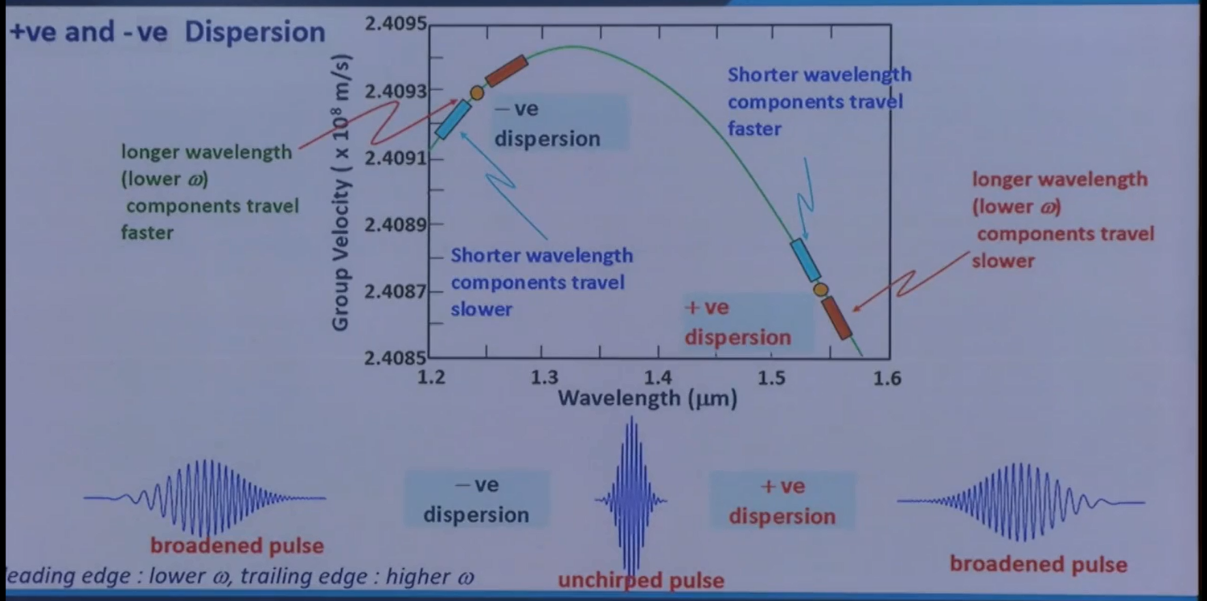

Slide 97
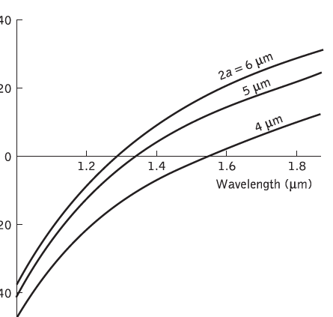
Hence for a particular wavelength, designated λ0, which is slightly larger than the ZMD point wavelength, the waveguide dispersion compensates for the material dispersion and the total dispersion parameter DT becomes zero.
The wavelength at which the dispersion is zero, λ0, may be selected in the range 1.3 to 2 μm by careful control of
the fiber core diameter and profile.

Slide 98
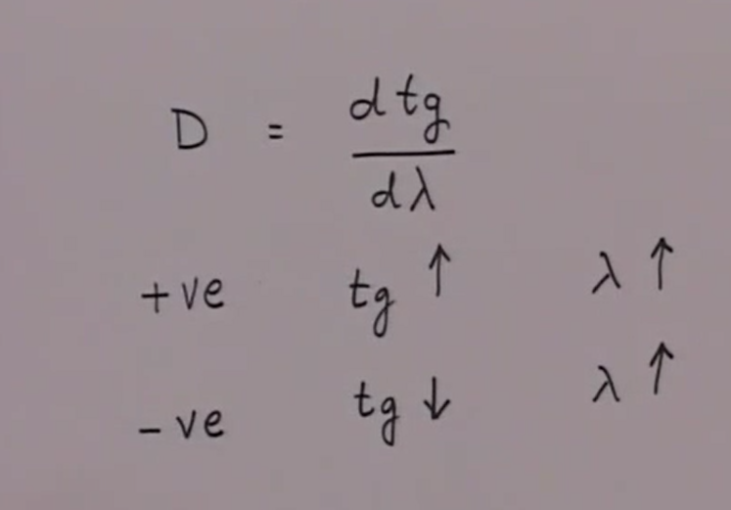

Slide 99
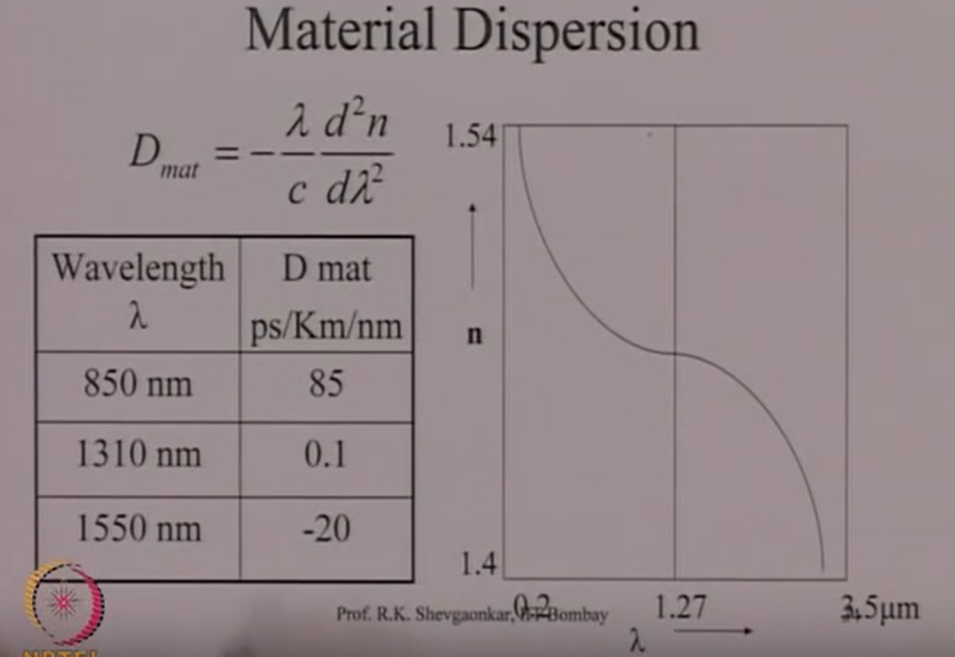

Slide 100
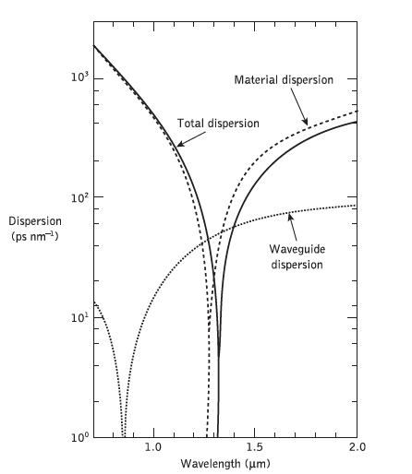
The effect of the interaction of material and waveguide dispersion on λ0 is also demonstrated in the dispersion against wavelength characteristics for a single-mode silica core fiber shown in Figure

Slide 101
The ZMD point occurs at a wavelength of 1.276 μm for pure silica, but that the influence of waveguide dispersion shifts the total dispersion minimum towards the longer wavelength giving a λ0 of 1.32 μm.
The wavelength at which the dispersion is zero, λ0, may be extended to wavelengths of 1.55 μm and beyond by a combination of three techniques. These are:
(a) lowering the normalized frequency (V value) for the fiber;
(b) increasing the relative refractive index difference Δ for the fiber;
(c) suitable doping of the silica with germanium.

Slide 102
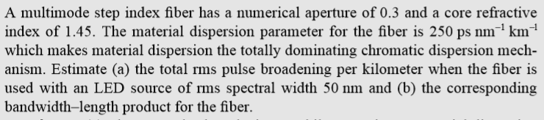

Slide 103
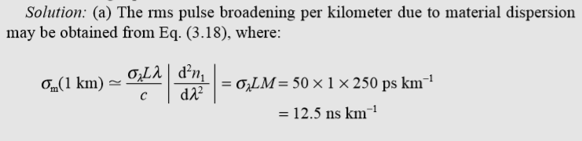

Slide 104
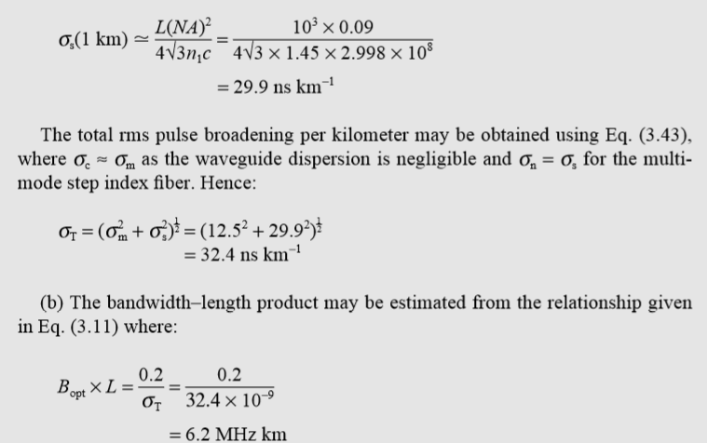

Slide 105

DETAILED ANALYSIS OF TOTAL DISPERSION IN SINGLE MODE FIBERS
The transit time or specific group delay τg for a light pulse propagating along a unit length of single-mode fiber may be given
where c is the velocity of light in a vacuum, β is the propagation constant for a mode within the fiber core of refractive index n1 and k is the propagation constant for the mode in a vacuum.

Slide 106



The total first-order dispersion parameter or the chromatic dispersion of a single-mode fiber, DT, is given by the derivative of the specific group delay with respect to the vacuum wavelength
When the variable λ is replaced by ω, then the total dispersion parameter becomes
The fiber exhibits intramodal dispersion when β varies nonlinearly with wavelength.

Slide 107
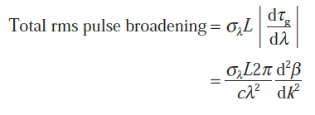

The rms pulse broadening caused by chromatic dispersion down a fiber of length L is given by the derivative of the group delay with respect to wavelength as
The variation of the chromatic dispersion with wavelength is usually characterized by the second-order dispersion parameter or dispersion slope S

Slide 108

Whereas the first-order dispersion parameter DT may be seen to be related only to the second derivative of the propagation constant β with respect to angular frequency but the dispersion slope can be shown to be related to both the second and third
Derivatives.
It should be noted that although there is zero first-order dispersion at λ0, these higher order chromatic effects impose limitations on the possible bandwidths that may be achieved with single-mode fibers

Slide 109

An important value of the dispersion slope S(λ) is obtained at the wavelength of minimum chromatic dispersion λ0 such that:
S0 = S(λ0)
S0 is called the zero-dispersion slope
Typical values for the dispersion slope for standard single-mode fiber at λ0 are in the region 0.085 to 0.095 ps nm−2 km−1
The total chromatic dispersion at an arbitrary wavelength can be estimated when the two parameters λ0 and S0 are specified

Slide 110
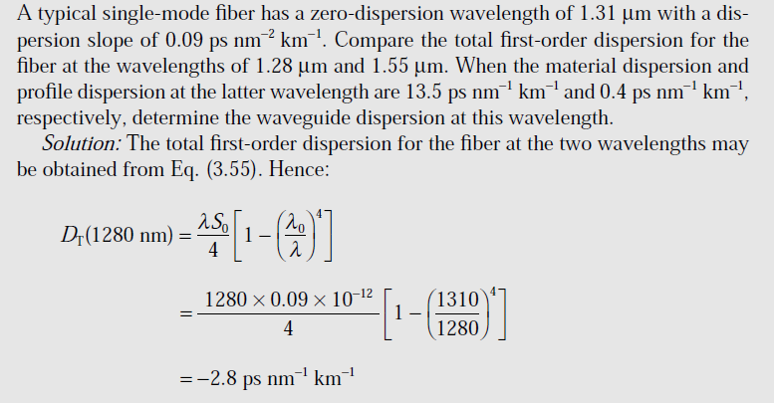

Slide 111
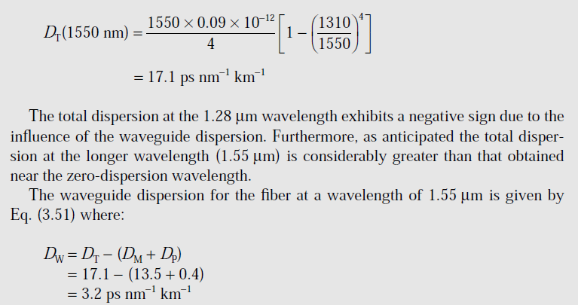

Slide 112
Dispersion modified fibers
It is possible to modify the dispersion characteristics
of single-mode fibers by the tailoring of specific fiber parameters.
2 types of dispersion modified fibers are there
(1)- Dispersion shifted fibers (DS) fibers
(2)- Dispersion flattened fibers (DF)
DS fibers
At wavelengths longer than the ZMD point in most common fiber designs, the DM and DW components are of opposite sign and can therefore be made to cancel at some longer wavelength.

Slide 113
Hence the wavelength of zero chromatic dispersion can be shifted to the lowest loss wavelength for silicate glass fibers at 1.55 μm to provide both low dispersion and low-loss fiber.
This may be achieved by reduction in the fiber core diameter with an accompanying increase in the relative or fractional index difference to create so-called dispersion-shifted single-mode fibers (DSFs).
Typical value for core diameter and fractional index difference are 4.4um and .012 respectively
However, this design has resulted in specific, different refractive index profiles for these dispersion-modified fibers.

Slide 114

Dashed line-- RI profile of conventional non shifted fiber
Solid line – RI profile of DS fibers
For suitable power confinement of the fundamental mode, the normalized frequency V should be maintained in the range 1.5 to 2.4 μm and the fractional index difference must be increased as a square function while the core diameter is linearly reduced to keep V constant.
This is normally achieved by substantially increasing the level of germanium doping in the fiber core.

Slide 115
A problem that arises with the simple step index approach to dispersion shifting is that the fibers produced exhibit relatively high dopant-dependent losses at operation wavelengths around 1.55 μm.
This excess optical loss, which may be of the order of 2 dB /km may result from refractive index inhomogeneities associated with waveguide variations at the core–cladding interface.
This can be reduced by grading the material composition and therefore an investigation of graded index single-mode fiber designs has to consider
One of the graded profile is triangular profile which exhibit
the same low loss (i.e. 0.24 dB/ km)of conventional fibers at a wavelength of 1.56 μm

Slide 116


A second grading profile can be adopted is of Gaussian profile.
This profile, which was achieved using the vapor axial deposition fabrication process produced losses of 0.21 dB /km at the λ0 wavelength of 1.55 μm.
The alternative approach for the production of DSF has involved the use of multiple index designs.
One is the use of multiple index triangular profile fibers

Slide 117


Dual-shaped core DSFs have also come under investigation in order to provide an improvement in bend loss performance over the 1.55 μm wavelength region .
A dual-shaped core refractive index profile is shown in Figure which illustrates a step index fiber design.

Slide 118
DF fibers
An alternative modification of the dispersion characteristics of single-mode fibers involves the achievement of a low-dispersion window over the low-loss wavelength region between 1.3 and 1.6 μm.
In order to obtain DFFs multilayer index profiles are fabricated with increased waveguide dispersion which is tailored to provide overall dispersion (e.g. less than 2 ps/km) over the entire wavelength range 1.3 to 1.6 μm.
In effect these fibers exhibit two wavelengths of zero total chromatic dispersion.

Slide 119

A typical W fiber index profile (double clad) is used to construct DF fibers.
drawbacks with the W structural design included the requirement for a high degree of dimensional control as well as a very high sensitivity to fiber bend losses

Slide 120

To reduce the sensitivity to bend losses associated with the W fiber structure, the light which penetrates into the outer cladding area can be retrapped by introducing a further region of raised index into the structure.
This approach has resulted in the triple clad (TC) and quadruple clad (QC) structures

Slide 121
Fiber attenuation measurements
Fiber attenuation measurement techniques have been developed in order to determine the total fiber attenuation of the relative contributions to this total from both absorption losses and scattering losses.
Measurement techniques to obtain the total fiber attenuation give either the spectral loss characteristic or the loss at a single wavelength (spot measurement).
Total fiber attenaution--Cut back / Differential method
A commonly used technique for determining the total fiber attenuation per unit length is the cut-back or differential method

Slide 122

Cut back technique

Slide 123
It consists of a ‘white’ light source, usually a tungsten halogen or xenon arc lamp. The focused light is mechanically chopped at a low frequency of a few hundred hertz.
This enables the lock-in amplifier at the receiver to perform phase-sensitive detection.
The chopped light is then fed through a monochromator which utilizes a prism or diffraction grating arrangement to select the required wavelength at which the attenuation is to be measured.
Hence the light is filtered before being focused onto the fiber by means of a microscope objective lens.

Slide 124
A beam splitter may be incorporated before the fiber to provide light for viewing optics and a reference signal used to compensate for output power fluctuations
A mode scrambling device is attached to the fiber
within the first meter to achieve steady state mode distribution
The fiber is also usually put through a cladding mode stripper, which may consist of an S-shaped groove cut in the Teflon and filled with glycerine.
A mode stripper can also be included at the fiber output end to remove any optical power which is scattered from the core into the cladding down the fiber length.

Slide 125
The optical power at the receiving end of the fiber is detected using a p–i–n or avalanche photodiode.
Finally, the electrical output from the photodetector is fed to a lock-in amplifier, the output of which is recorded.
The cut-back method* involves taking a set of optical output power measurements over the required spectrum using a long length of fiber (usually at least a kilometer).
The fiber is then cut back to a point 2 m from the input end and, maintaining the same launch conditions, another set of power output measurements is taken.

Slide 126


L1 and L2 are the original and cut-back fiber lengths respectively, and P01 and P02 are the corresponding output optical powers at a specific wavelength from the original and cut-back fiber lengths

Slide 127
Other methods to measure attenuation
Single wavelength attenuation measurements using interference filters
A temperature measurement technique using a thermocouple to determine fiber absorption loss measurement.
Fiber scattering loss measurement

Slide 128
Fiber dispersion measurements
The measurement of dispersion allows the bandwidth of the fiber to be determined.
Dispersion effects may be characterized by taking measurements of the impulse response of the fiber in the time domain, or by measuring the baseband frequency response in the frequency domain
If it is assumed that the fiber response is linear with regard to power, a mathematical description in the time domain for the optical output power Po(t) from the fiber may be obtained by convoluting the power impulse response h(t) with the optical input power Pi(t) as

Slide 129



It may be evaluated using convolution integral
In the frequency domain the power transfer function H(ω) is the Fourier transform of h(t) and therefore by taking the Fourier transforms of all the functions, rewrite 1st equation

Slide 130
where ω is the baseband angular frequency. The frequency domain representation given in last equation is the least mathematically complex, and by performing the Fourier transformation (or the inverse Fourier transformation) it is possible to switch between the time and frequency domains (or vice versa) by mathematical means.
Hence, independent measurement of either h(t) or H(ω) allows determination of the overall dispersive properties of the optical fiber.
Thus fiber dispersion measurements can be made in either the time or frequency domains

Slide 131

Time domain measurement
The most common method for time domain measurement of pulse dispersion in multimode optical fibers is illustrated in Figure

Slide 132
Short optical pulses (100 to 400 ps) are launched into the fiber from a suitable source (e.g. A1GaAs injection laser) using fast driving electronics.
The pulses travel down the length of fiber under test (around 1 km) and are broadened due to the various dispersion mechanisms.
The pulses are received by a high-speed photodetector (i.e. avalanche photodiode) and are displayed on a fast sampling oscilloscope.
A beam splitter is utilized for triggering the oscilloscope and for input pulse measurement.

Slide 133
After the initial measurement of output pulse width, the long fiber length may be cut back to a short length and the measurement repeated in order to obtain the effective pulse width.
The fiber is generally cut back to the lesser of 10 m or 1% of its original length
Dispersion measurements are normally made on pulses using the half maximum amplitude or 3 dB points
If Pi(t) and Po(t) are assumed to have a Gaussian shape then it may be written in the form:

Slide 134


where τi(3 dB) and τo(3 dB) are the 3 dB pulse widths at the fiber input and output, respectively, and τ (3 dB) is the width of the fiber impulse response again measured at half the maximum amplitude.
Hence the pulse dispersion in the fiber

Slide 135
where τ(3 dB), τi(3 dB) and τo(3 dB) are measured in ns and L is the fiber length in km.
It must be noted that if a long length of fiber is cut back to a short length in order to take the input pulse width measurement, then L corresponds to the difference between the two fiber lengths in km
The above dispersion measurement techniques allow the total dispersion for multimode fibers to be determined.
It is clear, however, that chromatic or intramodal dispersion is an important transmission parameter,

Slide 136

particularly for single-mode fibers. Moreover, it can also be a significant distortion effect in multimode fibers even though intermodal dispersion is normally dominant.
A typical experimental arrangement to measure intramodal dispersion is given by

Slide 137

The pulse delay against optical wavelength is measured for both long and short fiber lengths .The source usually comprises multiple injection lasers possibly including wavelength tunable devices.
When ΔT(λ) is the delay difference for the length difference L1 − L2, then the specific group delay per unit length τg(λ),
Differentiation of this equation provides the chromatic dispersion DT

Slide 138


Then dispersion slope S is given by

